Slide 1

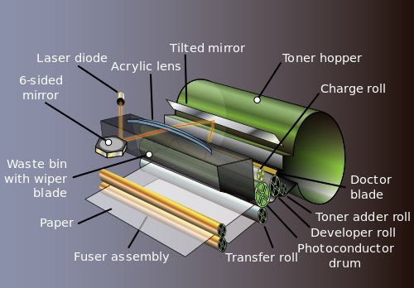
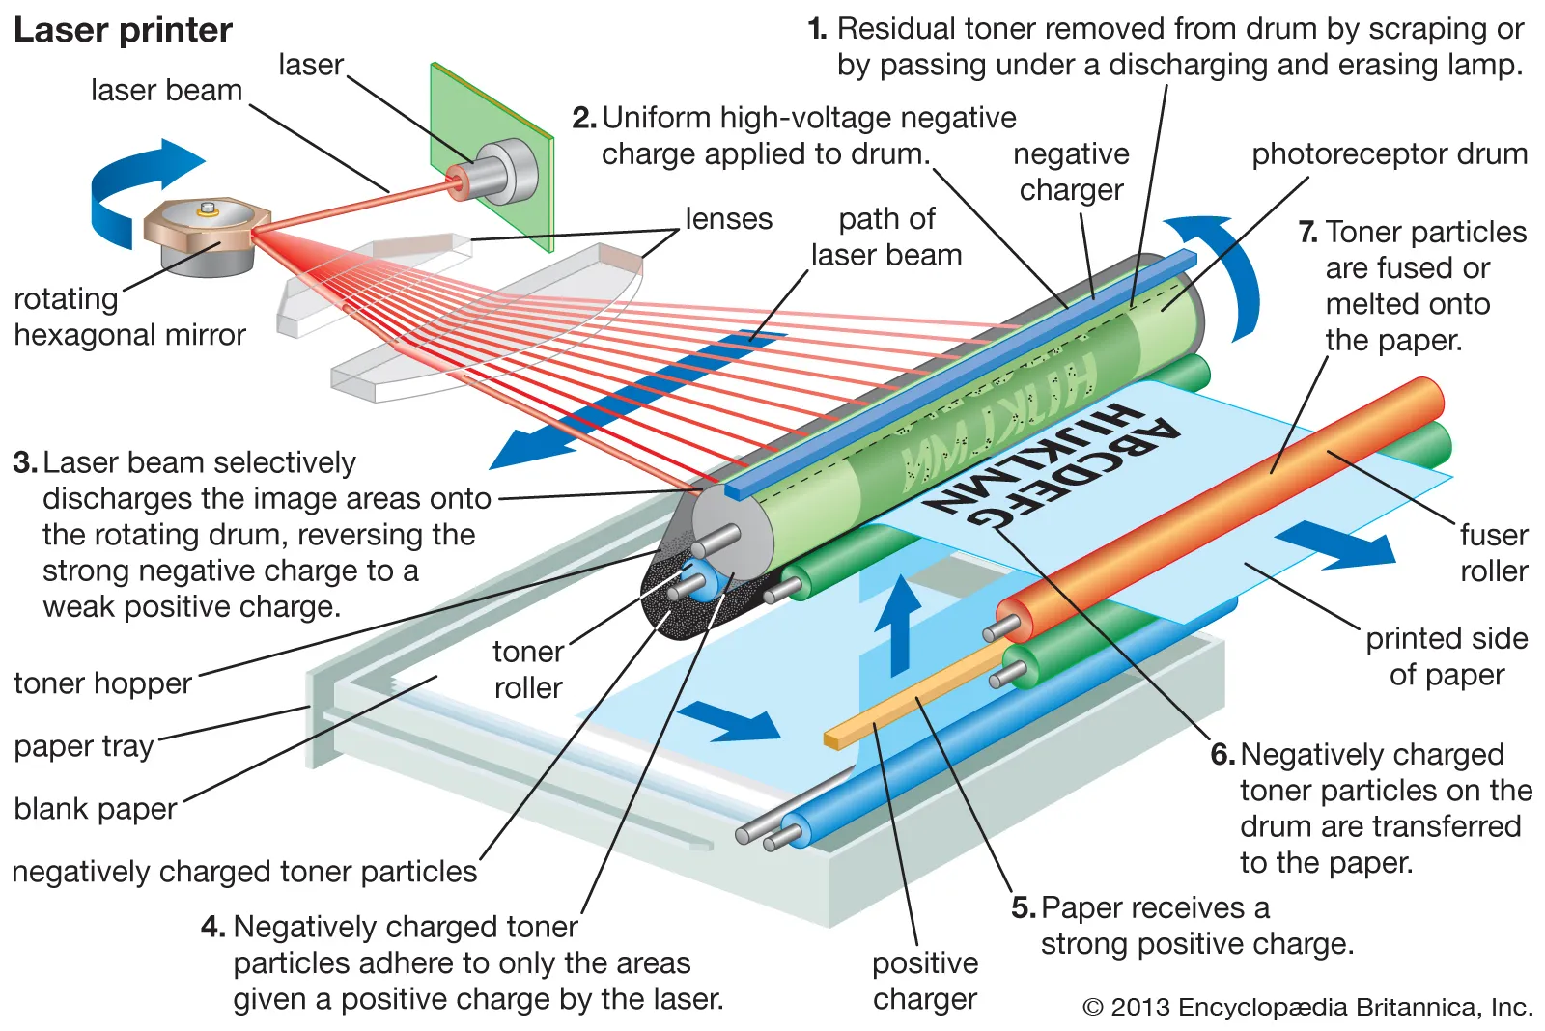
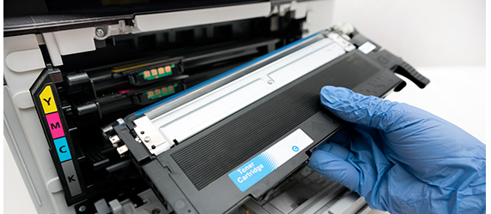
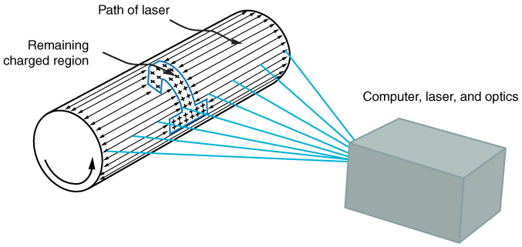
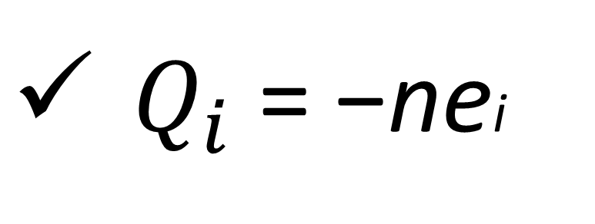
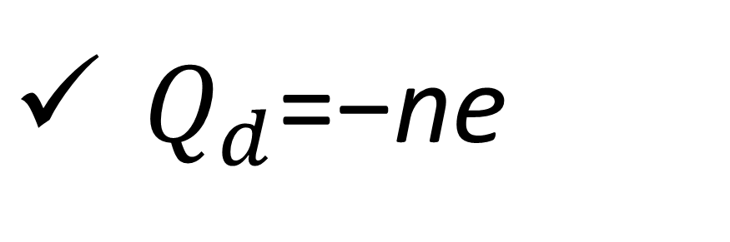

Physics-1 [Fall 2023-24]
Department of Physics (FST)
AMERICAN INTERNATIONAL UNIVERSITY–BANGLADESH (AIUB)
Faculty – Mst. Ummay Sumaya
Group - 05
23-52314-2 | CHOWDHURY, FARHAN
23-52315-2 | BANIK, NANDITA
23-52316-2 | SAIKAT, MD. SOBAHAN HASAN
23-52361-2 | SIDDIKI, NAYEM
23-52383-2 | HOSSAIN, SAHADAT
Laser Printer
The application of forces between charged bodies.
Introduction
Advantages of Laser Printing
In a laser printer, electrostatic force is fundamental to the printing process, primarily involving the interaction between charged components: the photosensitive drum, toner particles, and paper.
High-speed printing capabilities.
Exceptional print quality and resolution.
Cost-effective in the long run.
How Electrostatic Force Work
Applications
Charging the Drum:
Versatility in printing documents, graphics, and photos.
Ideal for business, academic, and personal use.
$Q_{d}$=−ne
Where,
n is the number of charge carriers (electrons)
e is the charge of an electron.
Laser Printer Features
Automatic duplex printing.
Wireless connectivity options.
Energy-efficient and environmentally friendly.
Laser Imaging:
$Q_{i}$​ = −nei​
Where,
ei​ is the reduced charge due to imaging.
Toner Application:
Coulomb's Law describes the force between charges:
F =$k\frac{Q_{1}Q_{2}}{r^{2}}$
Where:
F is the electrostatic force.
k is Coulomb's constant.
Q1​ and Q2​ are the magnitudes of the charges.
r is the distance between charges.
Conclusion
These equations outline the fundamental principles underlying the electrostatic forces at play in a laser printer. However, the intricate dynamics within the printer, including material properties, charge interactions, and system complexities, necessitate more elaborate models for precise calculations and optimization in real-world printing scenarios.
Toner Transfer to Paper:
Where:
F is the force on the charged particle.
q is the charge of the particle.
E is the electric field strength.
F=qE

